Slide 1
Mobile Computing
Session
GPRS
Dr. Navrati Saxena
IMT Ghaziabad

Slide 2
GPRS: data transfer over GSM
Two enhancements to GSM for data
  HSCSD - High Speed Circuit Switched Data
  GPRS - General Packet Radio Service
Both have capacity to use new coding schemes and to make multislot allocation
GPRS, being a packet switched service, is known to be more efficient and flexible for data transfer purposes
It delivers circuit and packet-switched services in one mobile radio network

Slide 3
GPRS features
Radio resources are allocated for only one or a few packets at a time, so GPRS enables
  many users to share radio resources, and allow efficient transport of packets
  fast setup/access times
  connectivity to external packet data networks
  volume-based charging
GPRS also carries SMS in data channels rather than signaling channels as in GSM

Slide 4
GPRS architectural detail
2G MS (voice only)
NSS
BSS
Abis
E
PSTN
PSTN
A
B
MS
BSC
MSC
C
GMSC
BTS
VLR
D
SS7
Gs
H
Gb
HLR
2G+ MS (voice & data)
AuC
Gr
Gc
Gn
Gi
PSDN
SGSN
IP
GGSN
BSS Base Station System
BTS Base Transceiver Station
BSC Base Station Controller
NSS Network Sub-System
MSC Mobile-service Switching Controller
VLR Visitor Location Register
HLR Home Location Register
AuC Authentication Server
GMSC Gateway MSC
SGSN Serving GPRS Support Node
GGSN Gateway GPRS Support Node
GPRS General Packet Radio Service

Slide 5

Packet Control Unit (PCU)
BTS
BSC
GSN
A_{bis}
PCU
G_{b}
GPRS
Function
MAC
Packet
Switching
CCU
RLC
RLC
Segmentation/Re-assembly
ARQ
MAC
Multiplexing (different mobiles)
Contention resolution (u/l) - QOS related
Scheduling/queueing (d/l) - QOS related

Slide 6
GSM to GPRS
Element
Software
Hardware
MS
Upgrade required
Upgrade required
BTS
Upgrade required
No Change
BSC
Upgrade required
PCU Interface
TRAU
No Change
No Change
MSC/VLR
Upgrade required
No Change
HLR
Upgrade required
No Change
SGSN
New
New
GGSN
New
New

Slide 7
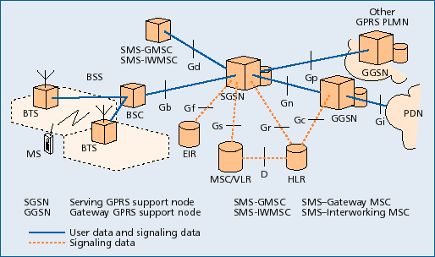
GPRS architecture

Slide 8
GPRS architecture
Requires addition of a new class of nodes called GSNs (GPRS Support Nodes)
  SGSN: Serving GPRS Support Node,
  GGSN: Gateway GPRS Support Node
BSC requires a PCU (Packet Control Unit) and various other elements of the GSM n/w require software upgrades
All GSNs are connected via an IP-based backbone. Protocol data units (PDUs) are encapsulated and tunneled between GSNs

Slide 9
GGSN
Serves as the interface to external IP networks which see the GGSN as an IP router serving all IP addresses of the MSs
GGSN stores current SGSN address and profile of the user in its location register
It tunnels protocol data packets to and from the SGSN currently serving the MS
It also performs authentication and charging
GGSN can also include firewall and packet-filtering mechanisms

Slide 10
SGSN
Analog of the MSC in GSM
Routes incoming and outgoing packets addressed to and from any GPRS subscriber located within the geographical area served by the SGSN
Location Register of the SGSN stores information (e.g. current cell and VLR) and user profiles (e.g. IMSI, addresses) of all GPRS users registered with this SGSN

Slide 11
BSC and others
BSC must get a Packet Control Unit to
  set up, supervise and disconnect packet-switched calls
  also support cell change, radio resource configuration and channel assignment
MSC/VLR, HLR and SMS Center must be enhanced for interworking with GPRS
MS must be equipped with the GPRS protocol stack

Slide 12
HLR - Home Location Register
Shared database, with GSM
Is enhanced with GPRS subscriber data and routing information
For all users registered with the network, HLR keeps user profile, current SGSN and Packet Data Protocol (PDP) address(es) information
SGSN exchanges information with HLR e.g., informs HLR of the current location of the MS
When MS registers with a new SGSN, the HLR sends the user profile to the new SGSN

Slide 13
VLR-Visitor Location Register
VLR is responsible for a group of location areas. It stores data of only those users in its area of responsibility
MSC/VLR can be enhanced with functions and register entries that allow efficient coordination between GPRS and GSM services
  combined location updates
  combined attachment procedures

Slide 14
GPRS MS
Transceiver consists of 2 sections:
  RF Front end:
    This section converts the GSM/TDMA signal into baseband signal in I/Q form.
  GPRS Signaling and Data codec:
    This section encodes/decodes signaling messages for GSM/TDMA Base station.
    Transcodes data into packets conforming with GPRS specifications.

Slide 15
MS modes
Class A: MS can operate simultaneous packet switched and circuit switched services
Class B: MS can operate either one at one time
  Most common for handsets today
Class C: MS can operate only packet switched services
  E.g. expansion cards for laptops

Slide 16
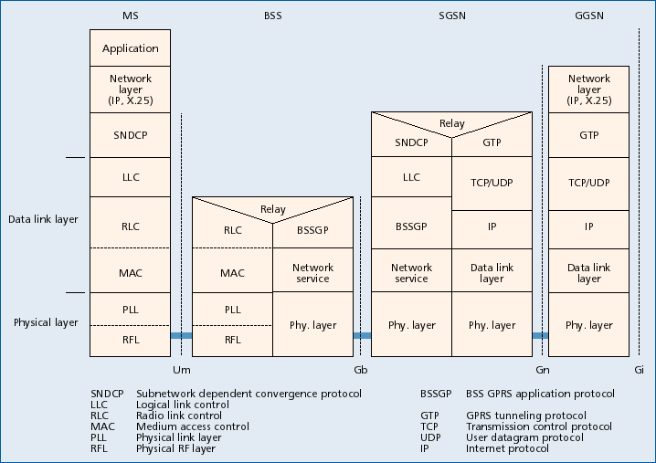
GPRS transmission plane

Slide 17


GSM v/s GPRS
Email via GPRS
Auth. Server
Email via GSM
Auth. Server
Email Server
Email Server
User
User
Modem
Modem
GPRS
Internet
GSM
PSTN
Internet
Virtual GPRS Data Tunnel
Authenticated path to Email server
INITIAL CALL PROCESS TIME (s)
GSM Call 4
TrainModem 30
Login and Authenticate 11
Download mail 180
Total 3 min 45s
SUBSEQUENT CALL
Repeat Above 3 min 45s
INITIAL CALL PROCESS TIME (s)
GPRS Call 4
Login and Authenticate 11
Download mail 180
Total 3 min 15s
SUBSEQUENT CALL
Not applicable –
Permanent Virtual Circuit 0min 0s

Slide 18
GPRS summary
Enables many users to share radio resources by dynamic, on-demand, multi-slot allocation
Provides connectivity to external packet data networks
Modification to the GSM air-interface
Addition of new GPRS Support Nodes
Assignment of PDP context to MS
Enables volume-based charging as well as duration based charging

